Slide 1

Today’s Program
Services Locations
New Patient Welcome Video
Performance—Quality Dashboard
Teeing up the Moves
Helping you with the transition
Campus Stars
Community Program Profile
February 2018
CEO
TOWN HALL
with Dr. Warren Browner, CEO
and Ameet Nanda, Site Leader/VP
Notes:
PAC Ameet Nanda – SA/VP
An exciting year/lot going on
Getting closer to 2020, and new hospitals are just around the corner
Key right now: communicating more with you re the transition/creating plans to ensure a smooth transition-for you and our patients.

Slide 2
Today’s Program
Services Locations
New Patient Welcome Video
Performance—Quality Dashboard
Teeing up the Moves
Helping you with the transition
Campus Stars
Community Program Profile
February 2018
CEO
TOWN HALL
with Dr. Warren Browner, CEO
and Diane Petruzzella, VP of Surgical Services
Notes:
CAL Diane Petruzzella – VP of Surgical Services
An exciting year/lot going on
Getting closer to 2020, and new hospitals are just around the corner
Key right now: communicating more with you re the transition/creating plans to ensure a smooth transition-for you and our patients.

Slide 3
Today’s Program
Davies Construction Updates
Mission Bernal and Van Ness Updates
Services Locations
New Patient Welcome Video
Performance—Quality Dashboard
Dealing with Change
Campus Star
Community Program Profile
February 2018
CEO
TOWN HALL
with Dr. Warren Browner, CEO
and Mary Lanier, CEO
Notes:
Davies Mary Lanier – CAO
An exciting year/lot going on
Getting closer to 2020, and new hospitals are just around the corner – Mission Bernal opens in just 6 months
A lot happening at Davies too.
We are ONE CPMC and these transitions touch all of us
It’s going to be a new world for CPMC.

Slide 4
Today’s Program
Services Locations Update
New Patient Welcome Video
Performance—Quality Dashboard
Teeing up the Moves
Helping you with the Transition
Campus Stars
Community Program
February 2018
CEO
TOWN HALL
with Dr. Warren Browner, CEO
and Shannon Thomas, Director of Nursing
Notes:
STL Shannon Thomas – Director of Nursing
An exciting year/lot going on
Getting closer to 2020, and new hospitals are just around the corner
Key right now: communicating more with you re the transition/creating plans to ensure a smooth transition-for you and our patients.
PAC Ameet Nanda – SA/VP
CAL Diane Petruzzella – VP of Surgical Services
Davies Mary Lanier – CAO
STL Shannon Thomas – Director of Nursing

Slide 5
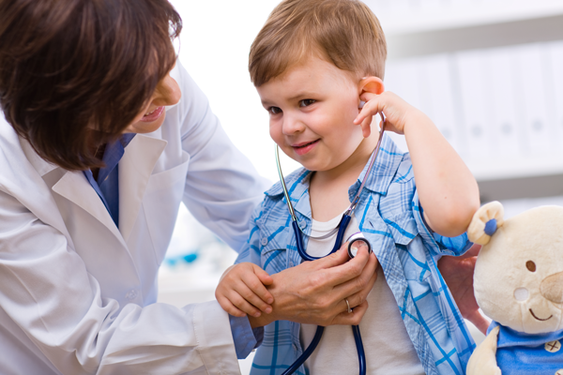

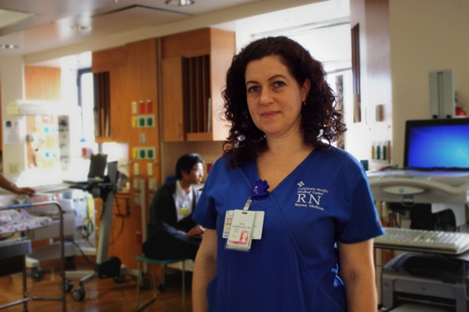

Our CPMC2020 Themes
erformance
are
C
P
e
M
C
ommunity
Notes:
Just a quick reminder re our CPMC2020 themes.
More than just bricks and mortar: 4 Themes moving forward
>>Need new photos

Slide 6
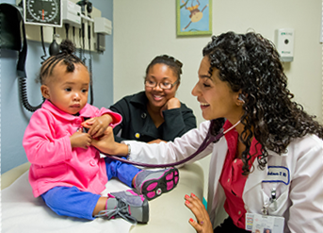
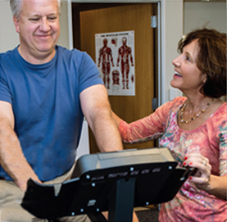
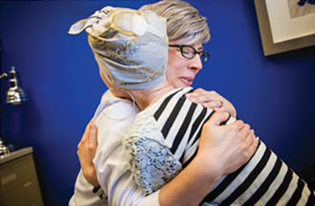
Care
Performance
Me
Community

Slide 7

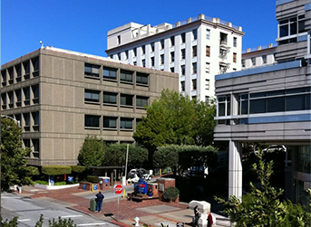
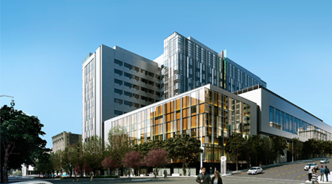

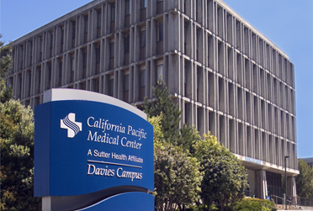
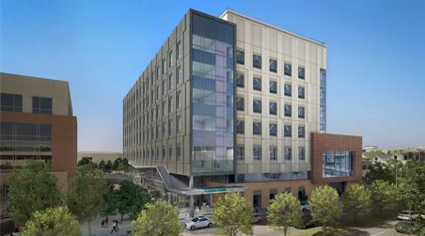
PACIFIC HEIGHTS Outpatient Only
CPMC2020: The Big Picture
Van Ness 274 Acute Beds
DAVIES 125 Acute & Rehab Beds
Mission bernal 120 Acute Beds

Slide 8

Davies Construction Update
Notes:
Who doesn’t know that a lot of construction is underway?
May not seem as exciting as new hospitals, but critical for both seismic compliance
And in some cases, like the ED, greatly improved staff and patient convenience.
Lot of domino effects!

Slide 9
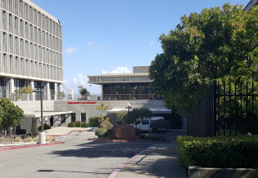
ED Expansion
Scheduled for Dec 2018 completion
Scheduled for December 2018 completion
New, more visible entrance
Separate ambulance entrance
Second door
New triage area
Dedicated waiting room
New travel path

Slide 10
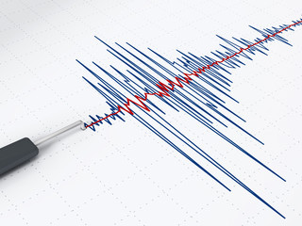
Seismic Separation: North Tower
Scheduled for Dec 2018 completion
Scheduled for December 2018 completion
Seismic compliance – must be self-contained
Impacts loading dock, food storage, staff lockers

Slide 11
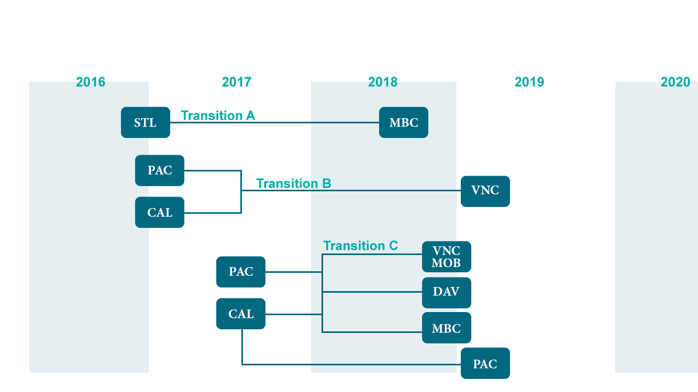
What’s going where
2017
2018
2019
2020
STL
MB
PAC
VN
CAL
VN MOB
PAC O/P
PAC
CAL O/P
MB
DAV
Notes:
For staff at the other campuses, where they are going to work has been an understandably a big question.
We are XXX percentage there in finalizing the locations, but here is a high level reminder.

Slide 12
Moving to Davies
From |  | To | When
PAC IP / OP Behavioral Health | ➔ | South Tower unoccupied portion | 2018 Q4 – Begin Improvements
St. Luke’s Sub Acute |  | Skilled Nursing | 2018 Q4 – Begin Improvements
Cal Pathology |  | South Tower B Level (former UCSF Lab) | 2018 Q3 – Begin?
Cal Orthopedics? |  | North Tower 3rd Floor | Pending
Pac PT / OT / SP? |  | PT / OT | 2020?
Notes:
New Colleagues and Construction Improvements.

Slide 13
Davies Internal Moves
Current |  | Floor | Service Line | When
TICU | ➔ | 4N Tele | Medsurg/Tele
Ambulatory Surgery 4North | ➔ | A Level | Pending Approval | 2-2.5 Years (Pending)

Slide 14
Moving From Davies
Department |  | Future Location
Nuclear Medicine | ➔ | Pac Renovated space Stanford Bldg.

Slide 15
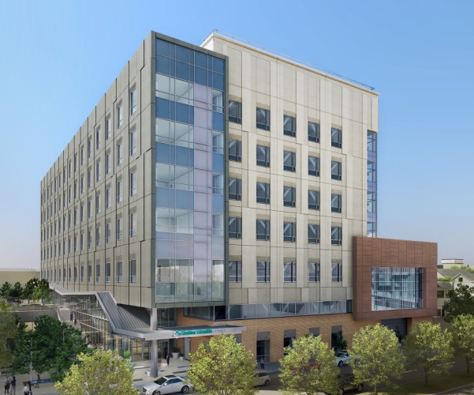
Mission Bernal
Key Dates
May: Construction Completed
June—August: Staff Training/Stock new hospital
August: Celebrations
August 25th: Patient Move
Notes:
More on these dates coming

Slide 16
Mission Bernal: Services I
Medical Services
Critical Care
General Medicine
Geriatrics
Medical Sub-Specialties
Surgical Services
ENT
General & Vascular Surgery
Gynecology
Ophthalmology
Orthopedics
Urology
Obstetrics
Notes:
For STL – Most of you will move right next door.

Slide 17
Mission Bernal: Services II
Additional Patient Services
Emergency
Antepartum Testing
Breast Health
Cardiac Rehab
Chapel
Diabetes Center
Non-Invasive Cardiology
Lab/Pathology
Newborn Connections
Pulmonary Function Lab
Pulmonary Rehab
Specialty Clinic & HCC
Radiology
Support/Admin Services
Admin
Care Coordination
Clinical Research
Engineering
EVS Offices
Info Services
Interpreter Services
Pharmacy
Scheduling
Volunteer Office
Notes:
For STL – Most of you will move right next door.

Slide 18
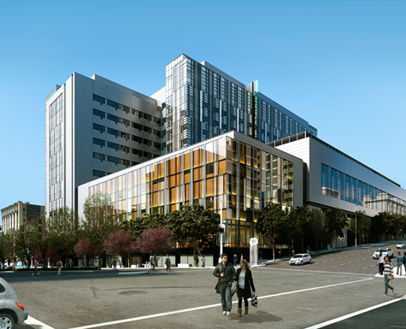
Van Ness Campus
Key Dates
August 2018: Construction completed
September-October: Staff Training/Stock new hospital
Feb & March 2019: Celebrations
March 2-3, 2019: Patient Move
Notes:
More on these dates coming

Slide 19
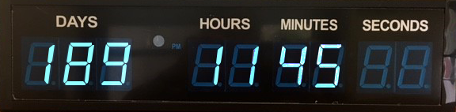
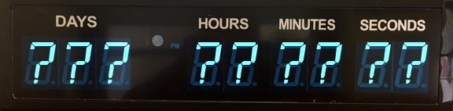
Mission Bernal Opening
August 25th - just six months away!
Timeclock now on mySutter Intranet
Notes:
It’s getting very real—escalation of activity leading up to August 25 patient move
We’re One CPMC, and the transition to both new hospitals will touch all of us
>>Eric ? (ST Lukes) – ??? Days to Aug 25th Opening.
PAC 189 according to mySutter
CAL 184
Dav 182
STL 179

Slide 20
75% complete
Construction Complete: August 2018
Patient Occupancy: March 2019
85% Complete
Construction Complete: May 1, 2018
Patient Occupancy: Late August 2018
New World, A better one
Mission Bernal campus
Van Ness campus
Notes:
These are not just makeovers. It’s going to be a whole new world for CPMC with Mission Bernal and Van Ness.
Remember when Cesar Chavez used to be called Army St? New name, new look – and no one talks about the old days any more.
-- Or remember what it was like before the EHR? Paper Charts, illegible handwriting?

Slide 21
Mission Bernal
Key Dates
May: Construction Completed
June—August: Staff Training/Stock new hospital
August: Celebrations
August 25th: Patient Move

Slide 22
Van Ness Campus
Key Dates
August 2018: Construction completed
September-October: Confirm Staff Training/Stock new hospital
Feb & March 2019: Celebrations
March 2-3, 2019: Patient Move

Slide 23
PACIFIC HEIGHTS Outpatient Only
CPMC2020: The Big Picture
Van Ness 274 Acute Beds
DAVIES 125 Acute & Rehab Beds
Mission bernal 120 Acute Beds
Notes:
You’ve seen this slide before.
Acknowledge that locations of services-where will I work?-has been a key question
For most of you, we now know to which campus you will move and where on that campus.
For some services, we’re still making decisions.
We are XXX% there in finalizing locations

Slide 24
Transition Timeline
2017
2018
2019
2020
STL
MB
PAC
VN
CAL
VN MOB
PAC O/P
PAC
CAL O/P
MB
DAV
Notes:
Another reminder

Slide 25
Service Locations
Where will I work?
Notes:
>>Eric Fun Art

Slide 26
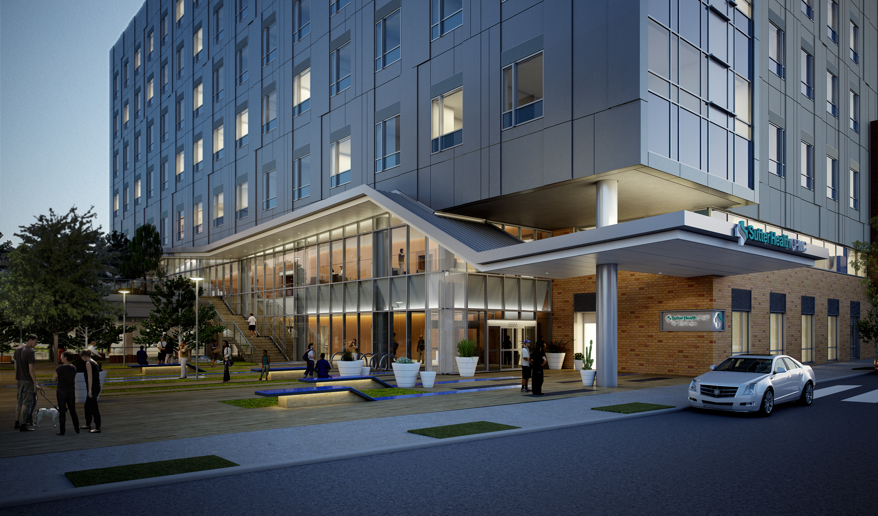
Mission Bernal services locations
Notes:
Reminder of what we reviewed at the last town hall.
STL ONLY Most of you will move right next door.

Slide 27
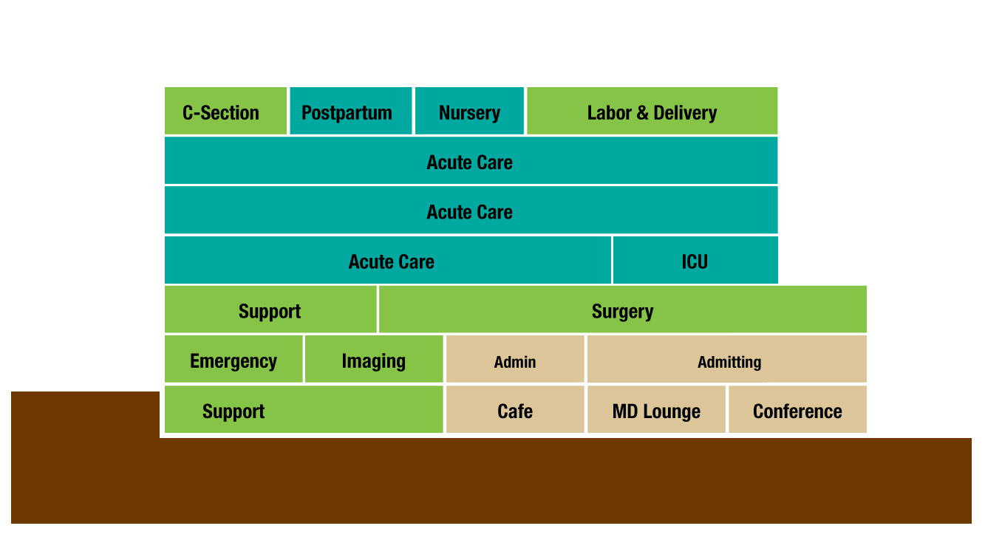
27th Street
Cesar
Chavez
Go to CPMC2020.org for Virtual Reality Views of Departments
Notes:
(ST Lukes ONLY Slide)

Slide 28
Mission Bernal: Services I
Medical Services
Critical Care
General Medicine
Geriatrics
Medical Sub-Specialties
Surgical Services
ENT
General & Vascular Surgery
Gynecology
Ophthalmology
Orthopedics
Urology
Obstetrics
Notes:
For STL – Most of you will move right next door.

Slide 29
Mission Bernal: Services II
Additional Patient Services
Emergency
Antepartum Testing
Breast Health
Cardiac Rehab
Chapel
Diabetes Center
Non-Invasive Cardiology
Lab/Pathology
Newborn Connections
Pulmonary Function Lab
Pulmonary Rehab
Specialty Clinic & HCC
Radiology
Support/Admin Services
Admin
Care Coordination
Clinical Research
Engineering
EVS Offices
Info Services
Interpreter Services
Pharmacy
Scheduling
Volunteer Office
Notes:
For STL – Most of you will move right next door.

Slide 30
Mission Bernal Auxiliary Buildings: I
Remain at 1912 Valencia
Breast Health
Chapel
Diabetes Center
EVS Offices
Remain at Monteagle / 1580 Valencia
Radiology
Lab Draw
MD Offices
Pharmacy
Specialty Clinics & HCC
Notes:
STL ONLY

Slide 31
Mission Bernal Auxiliary Buildings: II
Moving to 1912 Valencia
Admin
Care Coordination
MB Scheduling
Volunteer Office
Moving to Monteagle / 1580 Valencia
Engineering
Info Services
Interpreter Services
Newborn Connections Non-Invasive Cardiology
Moving to Hartzell Building (in 2019)
Admin
Antepartum Testing
Cardiac Rehab
Clinical Research
Engineering
Pulmonary Function Lab
Pulmonary Rehab
Notes:
STL ONLY

Slide 32
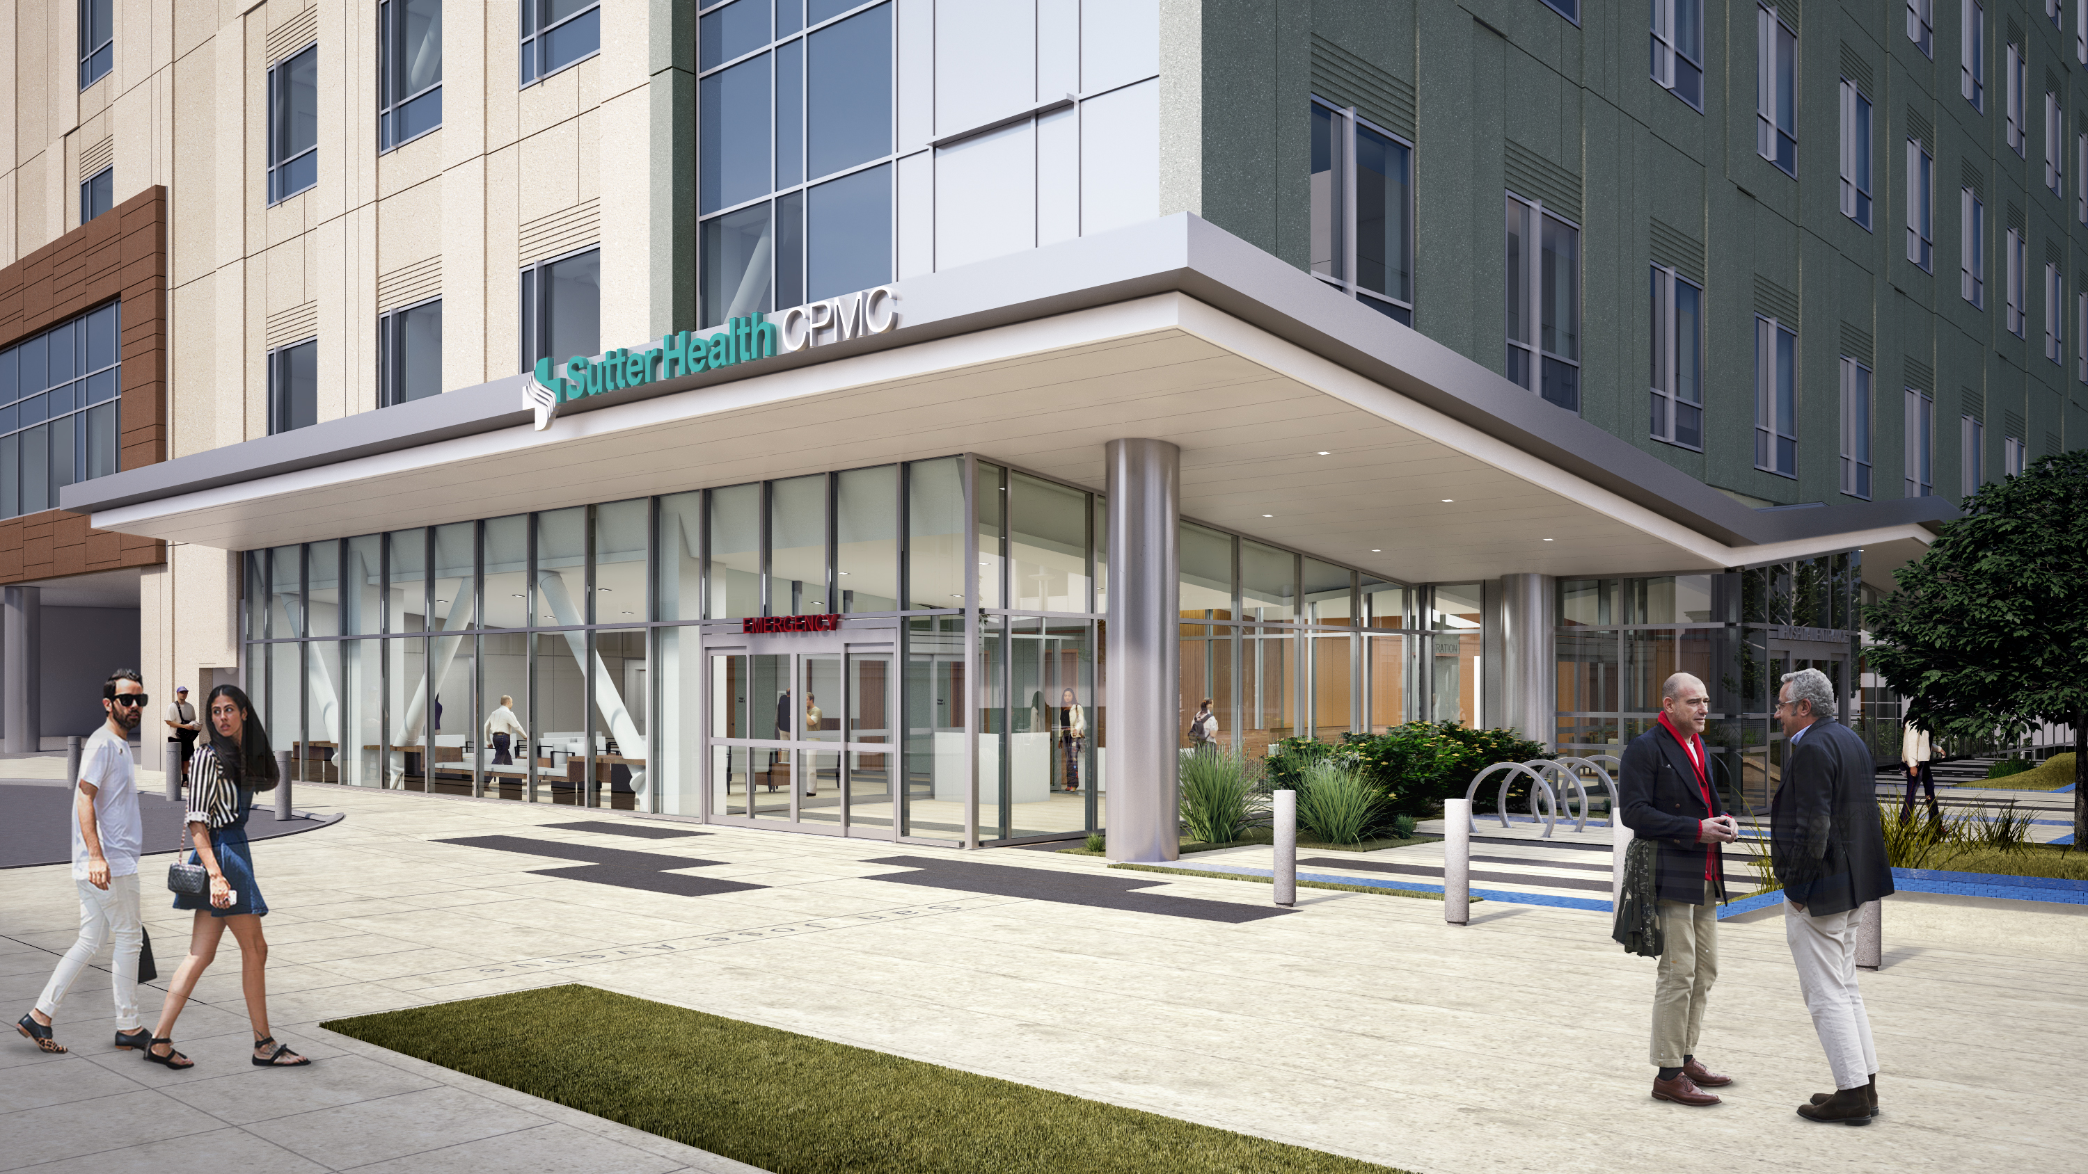
Hey. No peeking!
Notes:
(STL ONLY)
Pretty soon its going to look like Mission Bernal is ready for us. The construction fences will come down.
The construction team will be turning over the building to management.
But it’s still not for prime time, there won’t be any entry permitted for a while.
So be patient. You’ll be getting tours as part of the training program.

Slide 33

Services Locations
Where will I work?
Notes:
We’re XX% there.

Slide 34
PAC Inpatient
Current |  | Future | Service Line | Floor
ICU | ➔ | Van Ness | ICU | 6th
4 South MedSurg | ➔ | Van Ness | Cardiovascular | 10 East
4 North MedSurg | ➔ | TBD
5 South | ➔ | TBD
5 North | ➔ | TBD
6 South | ➔ | Van Ness | Transplant/GI | 10 West
6 North | ➔ | Van Ness | MedSurg Oncology | 9 East
TICU | ➔ | Van Ness | TICU | 9 East
Notes:
(PAC ONLY)
Regarding 4North, 5North and South. We yet know because frankly there are some complexities and we want to do it right.
For example if we move one of the units in its entirety to Mission Bernal will there be enough backup clinical support?
Or what about admitting and referring physicians and their preferences?
And then what about staffing, do we move a unit to one campus or split it among two or more campuses?
And where do individual staff members go, which requires discussions with union about matters such as seniority.
We’re working towards a decision hopefully in April.

Slide 35
PAC Outpatient and Ancillaries: I
Easy info first, all these departments remain in place
Ambulatory Surgery | Histo Lab
Cancer Center | Library Operations (Gerbode)
Cardiac NIL(?) | Melanoma (SPMF)
Care Coordination (Overflow) | Nuclear Medicine
Centralized Mail | Organ Failure Biorepository
Head & Neck (SPMF) | Program Medical & Human Values
HELP | Quality & Safety
Notes:
(PAC ONLY)

Slide 36
PAC Outpatient and Ancillaries: II
Current |  | Future Location (2019)
Accreditation & Licensing | ➔ | Renovated Stanford Building
Auxilio | ➔ | Renovated Stanford Building
Behavioral Health | ➔ | Davies
Cardiac Rehab | ➔ | Mission Bernal
CPMC Research Institute | ➔ | Renovated Stanford Building
Emergency Dept | ➔ | Van Ness
GI & IES | ➔ | Van Ness
Imaging | ➔ | Van Ness
Informatics | ➔ | Renovated Stanford Building
IS (PAC) | ➔ | Renovated Stanford Building
Melanoma & Head/Neck | ➔ | Renovated Stanford Building
PT/OT | ➔ | Davies
Pulmonary Rehab | ➔ | Mission Bernal
Notes:
(PAC ONLY)

Slide 37
CAL Inpatient
Current |  | Future | Service Line | Floor
Antepartum 1E, 2W | ➔ | Van Ness | Antepartum | 5th
Postpartum 2W, 4W | ➔ | Van Ness | Postpartum | 8th
Nursery | ➔ | Van Ness | Nursery | 8th
LDRP 2N, 2E | ➔ | Van Ness | LDR | 5th
NICU - N, E, W | ➔ | Van Ness | NICU | 5th
PICU | ➔ | Van Ness | PICU | 7th
Pedi Stepdown? | ➔ | Van Ness? | Pediatrics | ?7th
Pediatrics 5N | ➔ | Van Ness | Pediatrics | 7th
MedSurg 1East | ➔ | Davies | Ortho | 3N
Notes:
(CAL Only)
::Kathy/WB – Could these be arranged in a smarter/easier to search order.

Slide 38
CAL Outpatient and Ancillaries: I
Department |  | Future Location
Breast Care Clinic (SPMF) | ➔ | 2100 Webster
Breast Health Center | ➔ | PAC Renovated Stanford or Buchanan Building
Cancer Info Center | ➔ | TBD
Diabetes | ➔ | PAC Renovated Stanford or Buchanan Building
GME / FHC (SPMF) | ➔ | 2100 Webster
HIM | ➔ | TBD
Infection Control | ➔ | PAC Renovated Stanford or Buchanan Building
Medical Staff Services | ➔ | PAC Renovated Stanford or Buchanan Building

Slide 39
CAL Outpatient and Ancillaries: II
Department |  | Future Location
OB/GYN Ultrasound | ➔ | Van Ness MOB
Pathology | ➔ | Davies
Pharmacy (Limited / IV Compounding) | ➔ | PAC Renovated Stanford or Buchanan Building
Pelvic Medicine | ➔ | PAC Renovated Stanford or Buchanan Building
Risk Management | ➔ | PAC Renovated Stanford or Buchanan Building
Stanford Childrens | ➔ | Van Ness MOB
Women’s Health Resource Center | ➔ | PAC Renovated Stanford or Buchanan Building

Slide 40
Saint Luke’s Outpatient and Ancillaries
These services remain in place
Breast Health | 1912
Chapel | 1912
Diabetes | 1912
EVS Offices | 1912
Imaging | Monteagle
Lab Draw | Monteagle
Retail (Walgreens) | 1580 Valencia St.
Specialty Clinics & HCC | 1580 Valencia St.

Slide 41
Saint Luke’s Outpatient and Ancillaries
Department |  | Future Location
Admin | ➔ | 1912 & Hartzell Bldg
Antepartum Testing | ➔ | Hartzell Bldg
Cardiac Rehab | ➔ | Hartzell Bldg
Care Coordination | ➔ | 1912
Central Scheduling | ➔ | 1912
Clinical Research | ➔ | Monteagle
Engineering | ➔ | 1580 Valencia?M & Hartzell Bldg

Slide 42
Saint Luke’s Outpatient and Ancillaries
Department |  | Future Location
Info Services & Auxilio | ➔ | 1580 Valencia St?Monteagle
Interpreter Services | ➔ | 1580 Valencia St?Monteagle
Newborn Connections | ➔ | 1580 Valencia St?Monteagle
Non-Invasive Cardiology | ➔ | 1580 Valencia St?Monteagle
Pulmonary Function Lab | ➔ | Hartzell Bldg
Pulmonary Rehab | ➔ | Hartzell Bldg

Slide 43
Welcome Video Place holder
https://bcove.video/2lRdGhR
Notes:
Available at all campuses starting?

Slide 44
Care
Performance
Me
Community
Notes:
^{Importance of measuring} ^{how we are doing}
^{Investment in becoming a} ^{highly reliable organization}
^{Share, learn, reward}

Slide 45
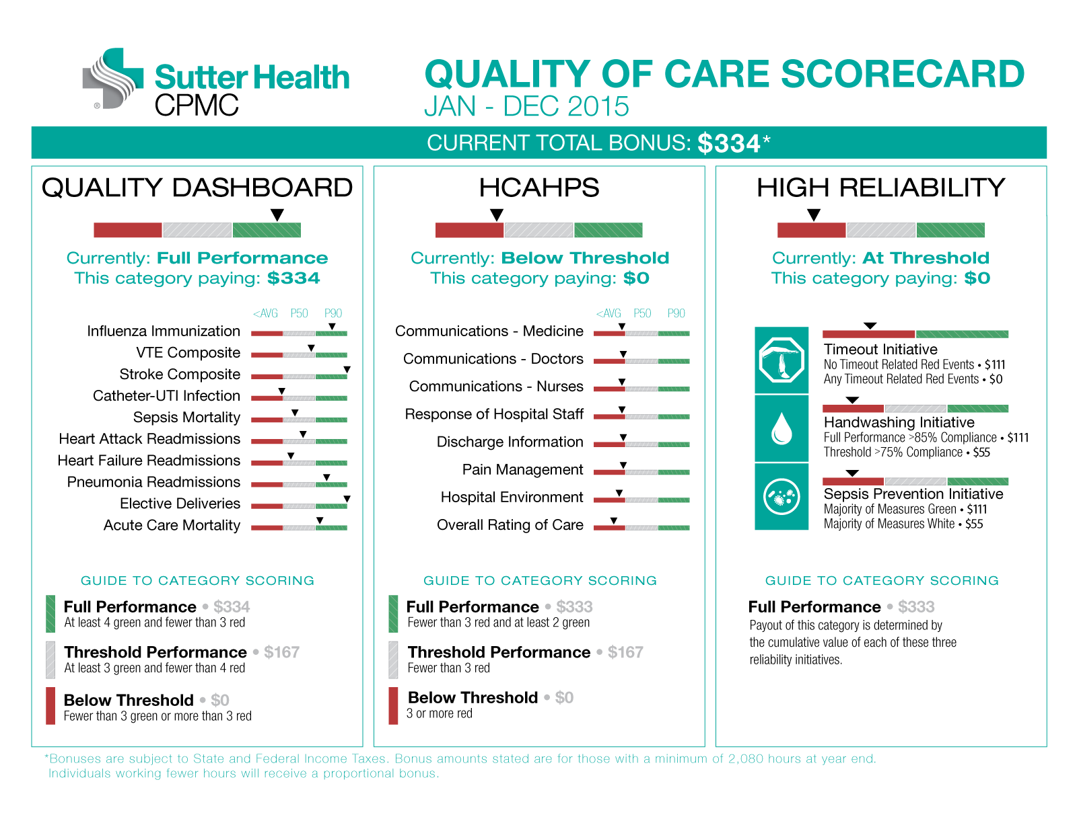
Notes:
ERIC: Update from Bing (new metrics?) Dollar Payouts? Kelly Kha?

Slide 46
HCAHPS Place holder
Notes:
>>EG : Patient Interaction Photo

Slide 47


Care
Performance
Me
Community
Handwashing is one of our three high reliability initiatives
How are we doing?

Slide 48
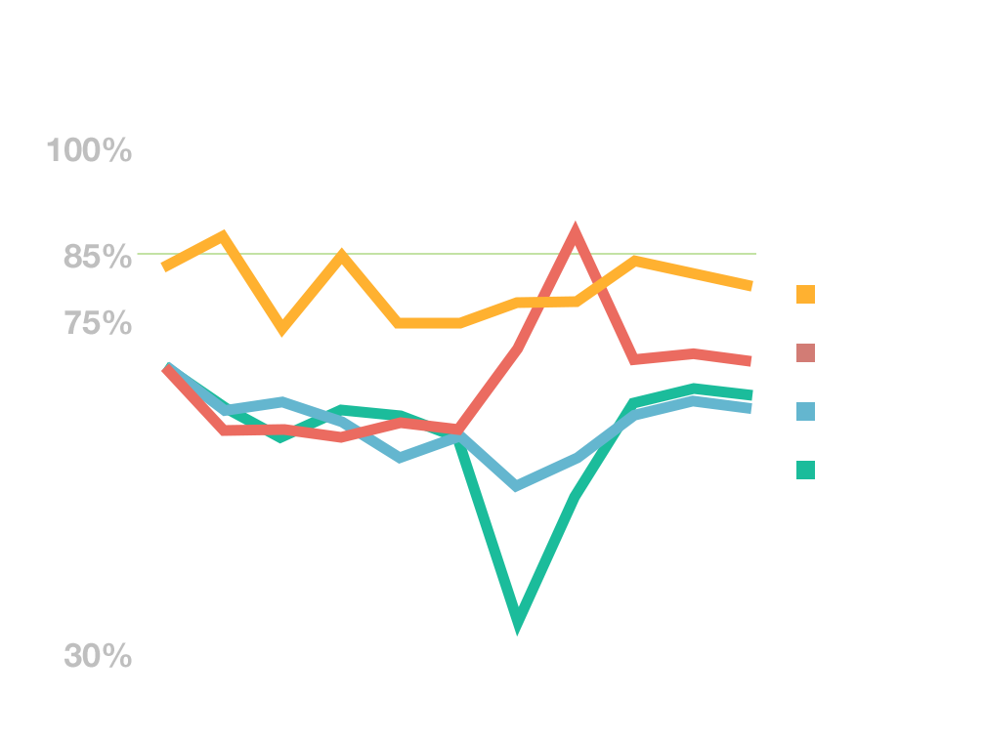
Handwashing
All CPMC Campuses
Congrats!
Goal Met
Notes:
>>EG UPDATE DATA from Manda

Slide 49

What’s going on with the Census?
Insert Census Trends Chart
Notes:
The trend is downward (all acute care hospitals?) even though there was a spike with the flu season.
Acknowledge this can be a concern, what does it mean to your job, #of shifts?
Will it change when we move into the new hospitals?

Slide 50
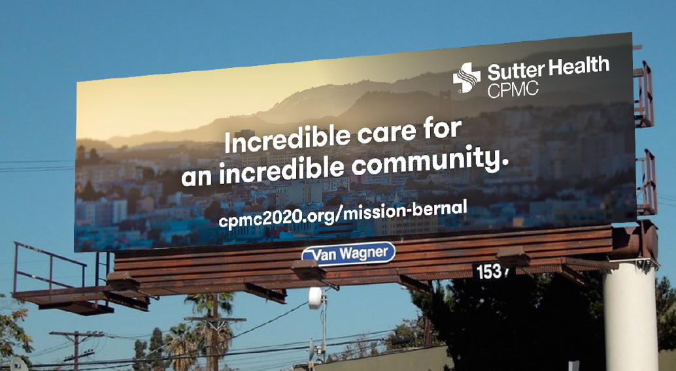
Solution?
grow the business
initial focus on Mission Bernal
• double the inpatient census (from 40 to 80)
• promote maternity, new ED, and new ACE unit for seniors
Notes:
Population Growth in SF focused on SOMA/Mission Bernal Area = a key opportunity
Also younger population: Have your baby at MB = Creates relationships/loyalty
Plus fantastic new ED to let community know about

Slide 51
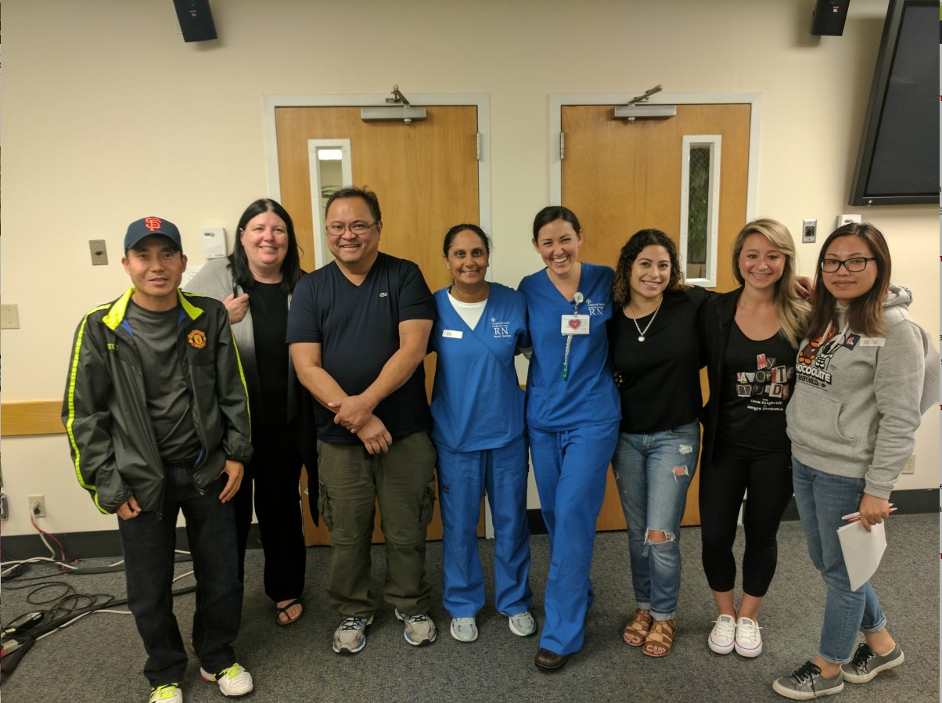
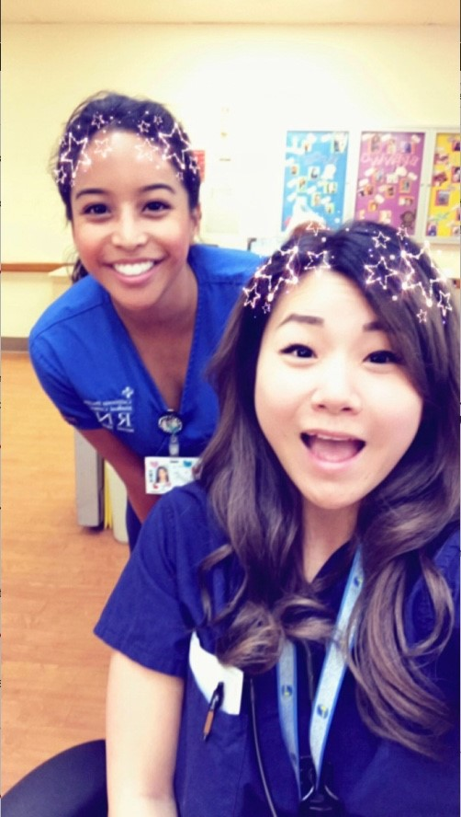
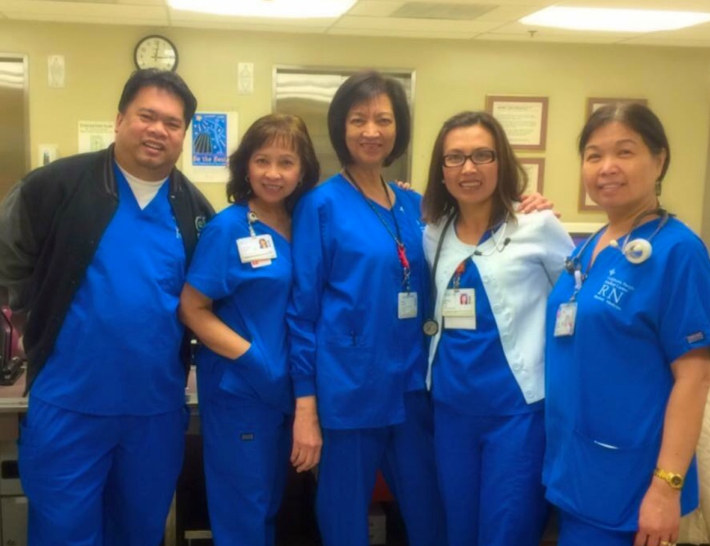
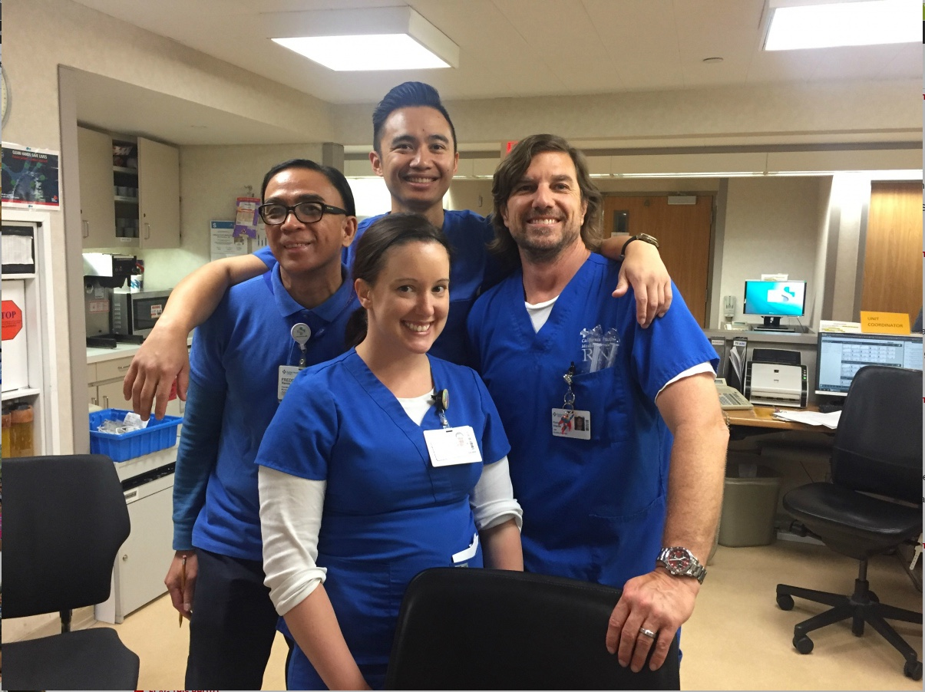
Care
Performance
Me
Community
Notes:
We are each an important and critical part of CPMC
A complex organization
Responsible to ourselves and our team for doing our best
Personal accountability

Slide 52

Change
A lot is happening at St. Luke’s, Cal, and Pac…
but change is happening at Davies too!

Slide 53

What is changing for you?
During Construction
relocation of ED registration and break room
food and nutrition disruption due to N Tower upgrade
restricted access to patio off of cafeteria
restricted access to loading dock
competition with construction crews for parking
Notes:
Davies employees have more to contend with than SLH or Pac/Cal employees- you are working in construction environment.

Slide 54
What will be different in your new world
new colleagues from other campuses
different types of cases in the OR
new physicians at the Castro building/some retirements
new, smaller conference center
elimination of parking on loading dock level
EVS lockers move to North Tower
wayfinding (no direct shot from MOB tunnel to Lab)
Notes:
Davies employees have more to contend with than SLH or Pac/Cal employees- you are working in construction environment.

Slide 55

Your #1 (and #2) questions about the new hospitals:
How will I
get to work?
Where will I park?
Notes:
For People moving to Van Ness, we’ll have more information in April. In the meantime here’s a reminder

Slide 56
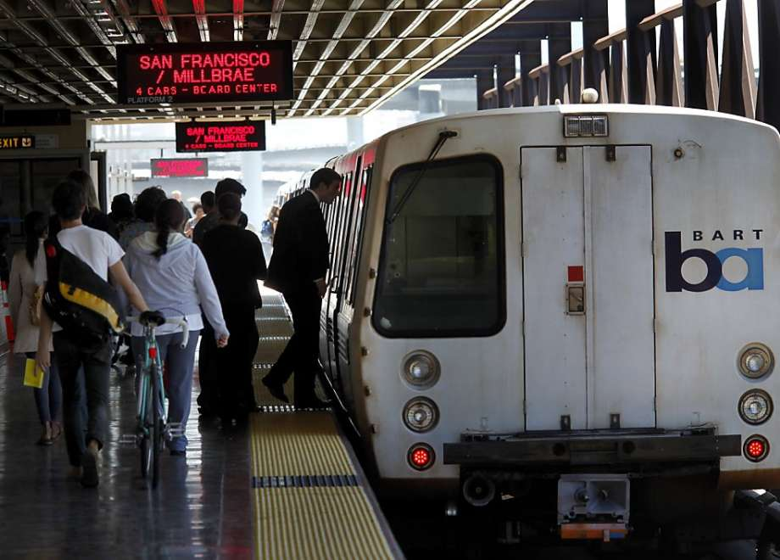

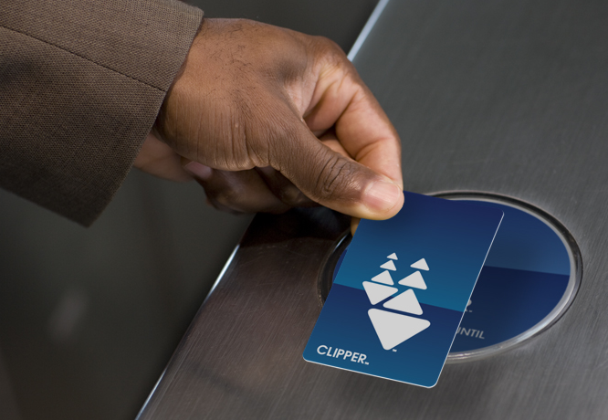
Our commitment to the City
Reduce the number of cars
Public transportation
Bike parking
Shuttles
Car pooling
Subsidies

Slide 57

What can you do right now?
Start using van pools
Use public transportation
Go online to: www.wework.org (for subsidies)

Slide 58
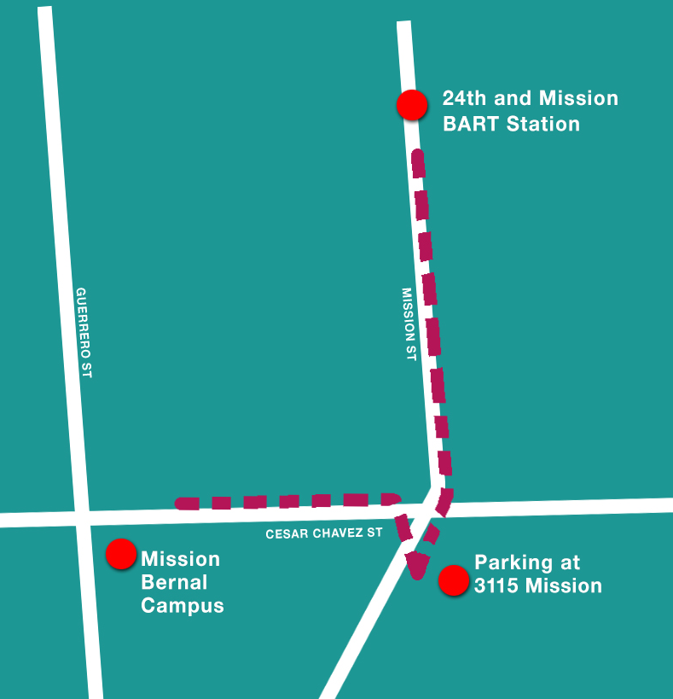
Starting Feb 2018: New Shuttle Mission Bernal to and from 24th St. BART
Every 30 minutes
6am – 6pm
Also picks up from off-campus parking lot at 3115 Mission St.
Notes:
Just for St Lukes Town Hall

Slide 59
Where will I park?
Existing campus garage
including evening and night shift
New: 3115 Mission St. (Construction Site Parking Lot)
60 spaces
4 minute walk from campus
Business Hours Only (for safety)
Notes:
Only for St. Lukes Town Hall

Slide 60
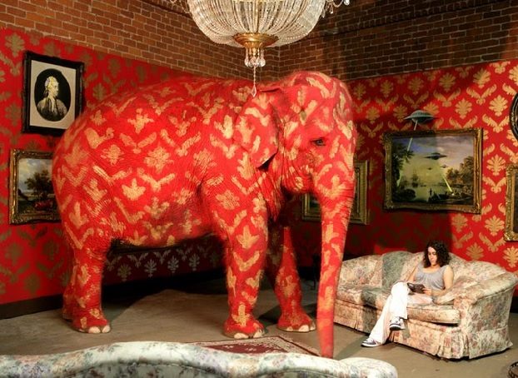
Teeing up the Move
Notes:
CGI photo

Slide 61
The next 18 months will be challenging for virtually everyone…
Lots of change
Notes:
It’s all about change and how we manage it. I know that some of you are concerned about what the services relocations, census trends and new technologies might mean to you
[Refer to Q&A developed by Tami – Draft
Goal = no job loss due to moves
For most, same job, new location
For some, perhaps different job description in a new location
For some, virtually no change at all regarding location or actual job]
Not to mention, a whole bunch of nitty gritty details.

Slide 62

10 things that could make you scream.
Oops- I drove to the wrong campus!
I want to punch in but I can’t find the timeclock
Do I turn right or left to get from the nursing station to the supply room?
I miss my favorite table in the cafeteria!
Yikes, I was looking for the WC and went into the broom closet instead!
I need the ATM machine but it’s moved
My favorite stapler isn’t in the same drawer any more
Where are those darned elevators?
We can’t use the usual Keurig coffee pot – how do I use the new one?
OMG, I’m leaving work and I forget where I parked my car!
Notes:
Animate one at a time
[If time seek audience participation]

Slide 63

Perspective
Notes:
We all cope with change differently – some embrace it, some fight it
Let’s face it, change is stressful
And, here’s the thing: on the list of stressful events in life – where does a hospital move stand? (lower on the list than a death in the family, a divorce, changing jobs0
It’s all about perspective!
Read poem – negative way first, then positive version. Perhaps share reading with Site Leader
The fact is: this is an exciting opportunity to make our work life better/be more effective with our patients

Slide 64
Practical Tips
Seek to understand the positive for you with this change.
Understand the benefits to patients, your team, and the organization.
If you’re unsure of what’s going on, ask your supervisor.
Share your concerns and questions with your Supervisor.
Issues can only be addressed if they are disclosed.
Information should flow both ways.
Employees to supervisors and vice-versa.
Attend scheduled trainings.
If you’re not feeling ready to work in a new environment help is available.

Slide 65
How we are going to help you through the transition
Notes:
It’s a tall order, but we can do it.
Lots of people working behind the scenes to plan the transition
Goal – to make it smooth for you and our patients
Here’s an overview – and you will be hearing more about these

Slide 66
Training! Training! Training!
Key to a successful transition
Notes:
Probably one of the most important parts of transition preparations –making sure you know the lay of the land, understand what will change, become familiar with the new environment
Wayfinding, equipment location, new processes

Slide 67
Training Schedule: Mission Bernal
April: Managers enroll employees in HealthStream (your manager will let you know!)
May 2 & 3: Equipment Fair ( a sneak peek at new equipment)
June 18 – July 12: General and Clinical Training
July & August: Department-level training
August: Physician Training
All training at new hospital!
Notes:
Probably one of the most important parts of transition preparations –making sure you know the lay of the land, understand what will change, become familiar with the new environment
Same approach for Van Ness

Slide 68
More about training
General Training
-required for all staff with St Luke’s cost center
-4 hours
-tours
-photos taken for new ID badges!
-giveaways
Clinical Training
- required
- 4 hours
-same afternoon as General
Department training
Required
Hours will vary
Your Director/Manager will inform you
Notes:
Probably one of the most important parts of transition preparations –making sure you know the lay of the land, understand what will change, become familiar with the new environment
Same approach for Van Ness

Slide 69
Tools you can use
Occupancy Manual – Everything you need to know
Rules of the Move – Do’s and Don’ts
Pocket Guide – Wayfinding
Notes:
There’s a lot to learn and remember, so we are creating some great tools
Occupancy Manual – everything you need to know. Will be on the intranet and a copy on each unit Examples details about ID badges, employee entrances, phone numbers, services locations, security, etc.
And, my favorite: each of you will get a Pocket Guide with wayfinding maps and key things to know and remember (HOLD ONE UP)

Slide 70
Wait! There’s more!
Pre-opening tours
Equipment Fairs
Resource people Facility Specialists and Move Captains
Communications Newsletters, Screensavers, FAQs, etc.
The CPMC intranet is your key source for transition information

Slide 71
Meet your Facility Specialists
Training guides for both Mission Bernal and Van Ness
From Pacific
Toni Da Costa 6 North
Jeane Schupp, 6 North
Meghan Burns, 6 North
Vincent Weiner, 4 South
Barbara Jenkins, 4 North
Chad Ortega, MSICU
Dan Stone, 4 South
From Cal
Maria Sassin, PICU
Margaret Runge, PICU
Darcy Mercord, ED
From St Luke’s
Maioni Alvero-Wilkes, ED
Notes:
12 RNs have volunteered to help with your training –at both MB and VN. They’ll be giving tours, teaching general orientation and Sutter Safe Care, and help with the new badges. They’ll be taking leaves from their current jobs.
Ask any in room to stand. Give them a big hand for helping!
Get to know them!

Slide 72

Fun and Celebrations!
August 5: Mission Bernal Open House (staff, physicians, community)
August 17: “Goodbye to St.Luke’s” staff event
August 24: Mission Bernal Dedication Event FIRM DATE?
February 2019: “Goodbye to Cal and Pac” staff events
March 2019: Van Ness Open House & Dedication Event
Notes:
We’re getting input from a special Employee Advisory Group

Slide 73
Celebrations!
August 5: Mission Bernal Open House (staff, physicians, community)
TBD???: Davies ED Opening Event
March 2019: Van Ness Open House & Dedication Event
Notes:
We’re getting input from a special Employee Advisory Group

Slide 74

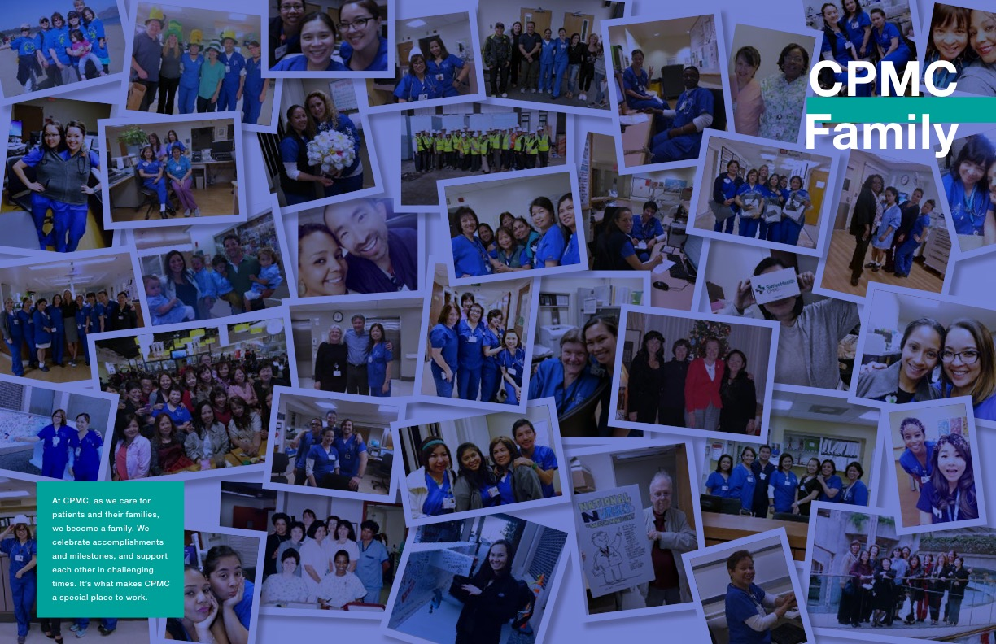
CPMC Yearbook
Notes:
Each of you will receive one – a celebration of the CPMC family
We’ve got photos of lots of you!
TBD _ distribution plan

Slide 75
Born at CPMC?
Be part of the CPMC2020 Yearbook
Any staff, volunteer or physician who was born at any of our four CPMC campuses.
send a baby photo and:
your name
year of birth
campus where you were born
campus / dept. where you work now
CPMC2020events@sutterhealth.org
Deadline: Monday, March 5

Slide 76
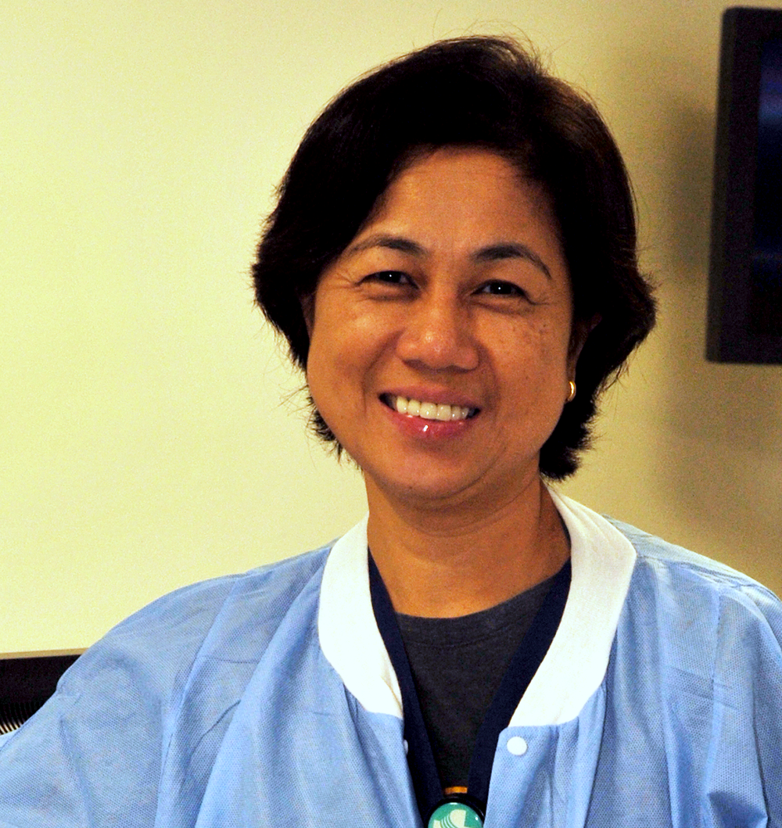
Dawit Asmelash
And now let’s take a moment to recognize one of our star employees…
And now, we want to take this time to recognize one of our own…
G.I. Tech
Pac Campus
Notes:
PAC
Here is what Dawit’s supervisor, Marc Villareal, had to say:
Dawit Asmelash is a simply outstanding G.I. tech working in IES. His work is consistently excellent, but more than that he exhibits every positive behavior one could hope for in a coworker.
The G.I. tech group as a whole is excellent and certainly hard-working, however we did experience a once in 14 year occurrence in January where not one, but two G.I. techs were on a leave at the same time due to circumstances beyond their control. This naturally coincided with an uptick in volume at all locations leaving us woefully short of qualified G.I. techs to maintain the instruments. I frankly did not have a good solution, and shared as much with the team. It required one tech to stay late and cross campuses to complete the work so that each unit would be prepared for the next day. Dawit Asmelash spoke up and volunteered that since it needed to be done, he would do so in the interest of our patients and keeping our units running.
Anyone who knows Dawit is aware that he is a soft spoken gentleman and the kindest of souls, but regarding this critical operational issue he was adamant about the work getting completed to the highest standard. He stayed not one night, not two, not three, but for a week and a half without a single complaint, additional request, or excuse. He just got it done, into each night with elegance and grace.
I am very proud to be working with a gentleman of this caliber and we are a stronger and more cohesive team with his teamwork and quiet leadership. We are very grateful to Dawit.

Slide 77
XXX
And now let’s take a moment to recognize one of our star employees…
And now, we want to take this time to recognize one of our own…
XXX
CAL Campus
Notes:
CAL

Slide 78
XXX
And now let’s take a moment to recognize one of our star employees…
And now, we want to take this time to recognize one of our own…
XXX
Davies Campus
Notes:
DAV
Here is what

Slide 79
Ron Villanueva, RN
And now let’s take a moment to recognize one of our star employees…
And now, we want to take this time to recognize one of our own…
Charge Nurse, ICU
St. Luke’s Campus
Notes:
STL
Here is what Ron’s supervisor, Michael Stevens, has to say about Ron:
Ron possesses the qualities of a true leader. As a charge nurse and a primary preceptor in the critical care unit, and as the nursing chair for the nursing unit council, he effectively sets and communicates vision, he leads change, and plans, organizes and coordinates. And, he oversees nursing care to achieve patient goals.
Ron is a role model for safety behaviors and initiates appropriate action when he sees unsafe practices. He has served as the sepsis champion in the ICU for the last five years and is now the lead RRT (???) nurse to support the Sutter Health initiative.. He’s also taken the lead nursing role in the ICU Liberation Project.
It’s pretty clear that Ron is eager to accept new tasks and responsibilities! He’s a great asset to the nursing team!

Slide 80
SLH Parking Team
And now let’s take a moment to recognize one of our star employees…
And now, we want to take this time to recognize one of our own…
Lucia Lacayo
Enrique Gomez
Guillermo Peralta
Notes:
STL
The parking garage is often the first interaction that patients and family members have with CPMC and the St Luke’s campus. They are also the first employees that all of us interact with when we arrive at work.
They are incredibly hard workers – and are responsive, energetic and courteous – setting the tone for what is expected of all of use. They greet staff and physicians by name, and get to know as many staff as possible. They also interact a lot with the neighborhood and help deal with the traffic and congestion from the construction site. They even have a relationship with the pigeons who live in the garage!
Lucia, Enrique, and Guillermo: thank you for being you! You put a smile on my face every morning when I arrive at work and when I’m leaving for the day.

Slide 81


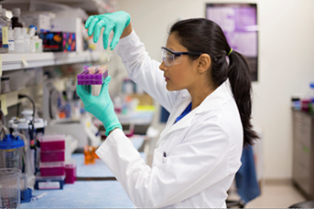
Our investment in the community
Care
Performance
Community
Care
Performance
Me
Community

Slide 82
De Marillac Academy
Description
https://bcove.video/2z2pgyV
Notes:
https://bcove.video/2z2pgyV

Slide 83


Questions?

Slide 84
Drawings! Evaluation Form …and thank you!

